Slide 2
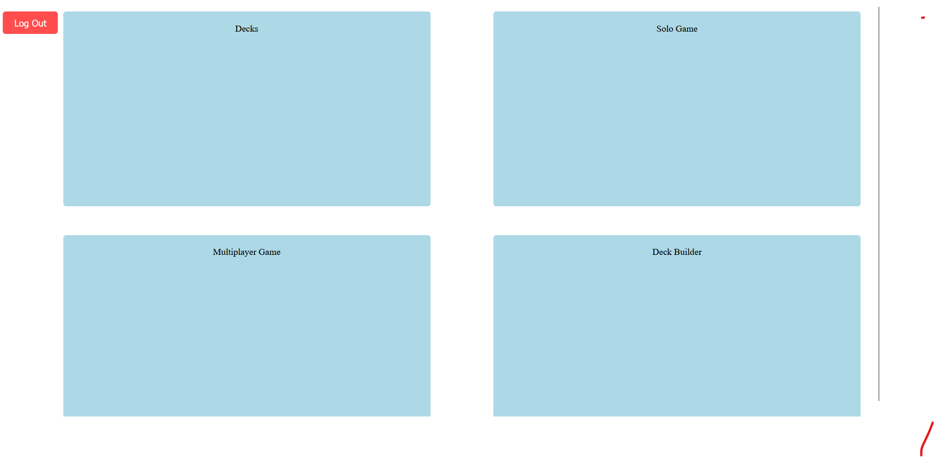
This directs you to where you import your decks and deal with the card data.
This directs you to play testing your deck by itself.
This is where you can build decks, searching for any card based on the card details.
This directs you to play testing with a total of 4 decks, simulating a game.

Slide 3
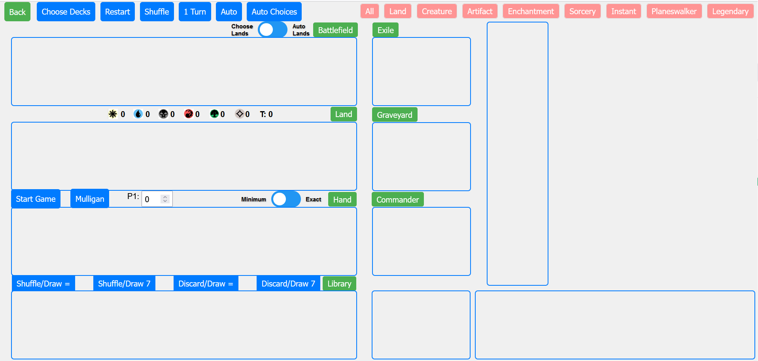
These are the game controls, where you can choose your decks, restart the game, shuffle your library, and play your turn.

Slide 4
The 1 turn button goes through 3 phases: the draw phase, playing a land, and playing card from your hand in which every time you press it, it goes to the next phase.

Slide 5
The Auto button goes through the phases automatically, with about a 2 second delay between each phase.

Slide 6
The 1 turn button goes through 3 phases: the draw phase, playing a land, and playing card from your hand in which every time you press it, it goes to the next phase.

Slide 7
The Auto Choices button goes through the phases where every time you have a choice, each card that you can play will be shown in the last section at the bottom right.
When this switch is on the Choose Lands option, it will make you choose the lands, but if the switch is turned on to auto lands, it will automatically play lands, but you choose the nonland cards to play.
Each card you can play will show up here, and when you click on the card, that is the card that will be played. After making your choice, it plays again. Currently, it will just let you choose 1 card, so if you can play more then 1, you can move any cards yourself before clicking the last card to be played.

Slide 8
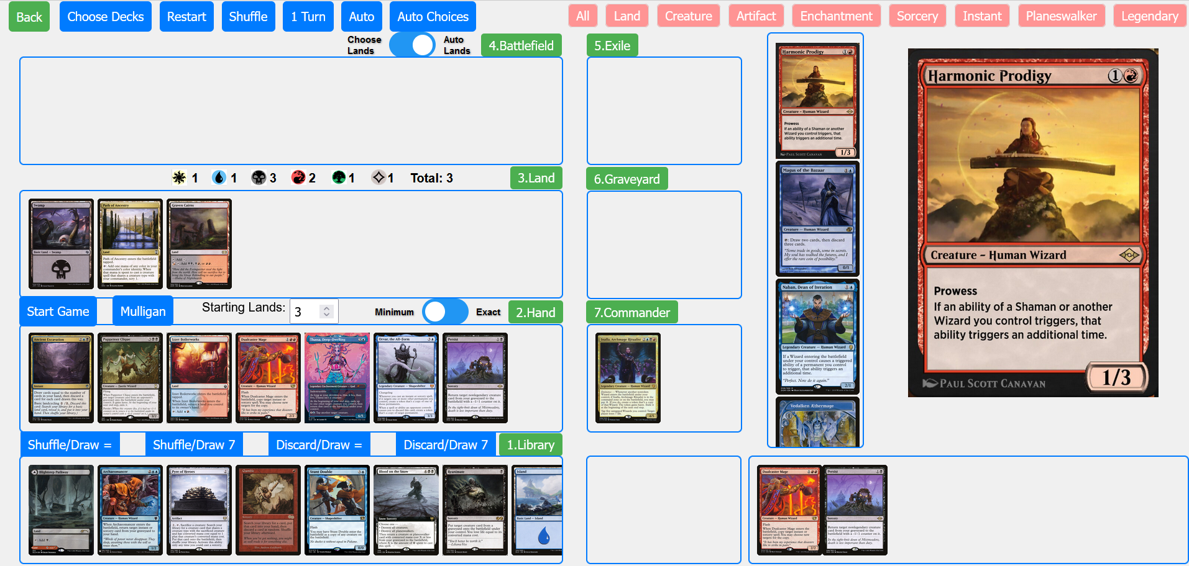
Each card you can play will show up here, and when you click on the card, that is the card that will be played. After making your choice, it plays again. Currently, it will just let you choose 1 card, so if you can play more then 1, you can move any cards yourself before clicking the last card to be played.

Slide 9
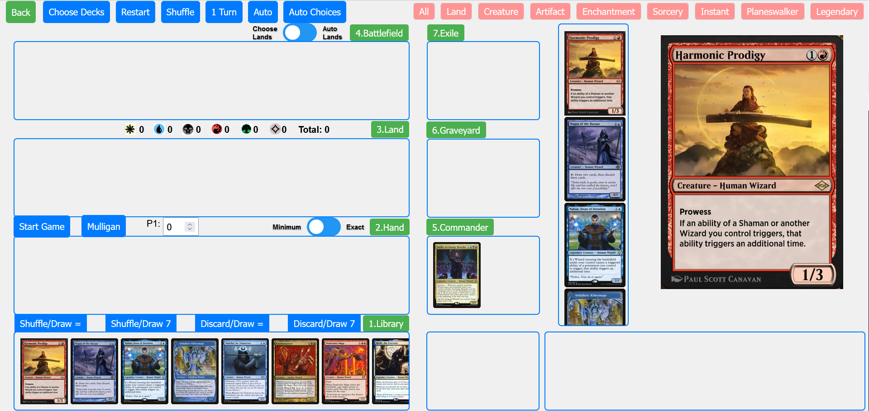
Your deck will be uploaded into this section, where before you start, you can click on the images to put a red marker on it, for cards that should not be played automatically. They will be cards like cards that are control cards, like instant or sorceries that destroy or exile permanents.

Slide 10
The tabs can be used to sort the cards, where you will only see the cards of that type in the deck section.

Slide 11
Your library is below here, where after you start the game, it will be shuffled.
You commander is placed in the command zone on the right.

Slide 12
To start the game, you can press the start game button here on the left. You can only press the start game button once, after that, you can press the mulligan button to shuffle those cards back into the library to draw again.

Slide 13
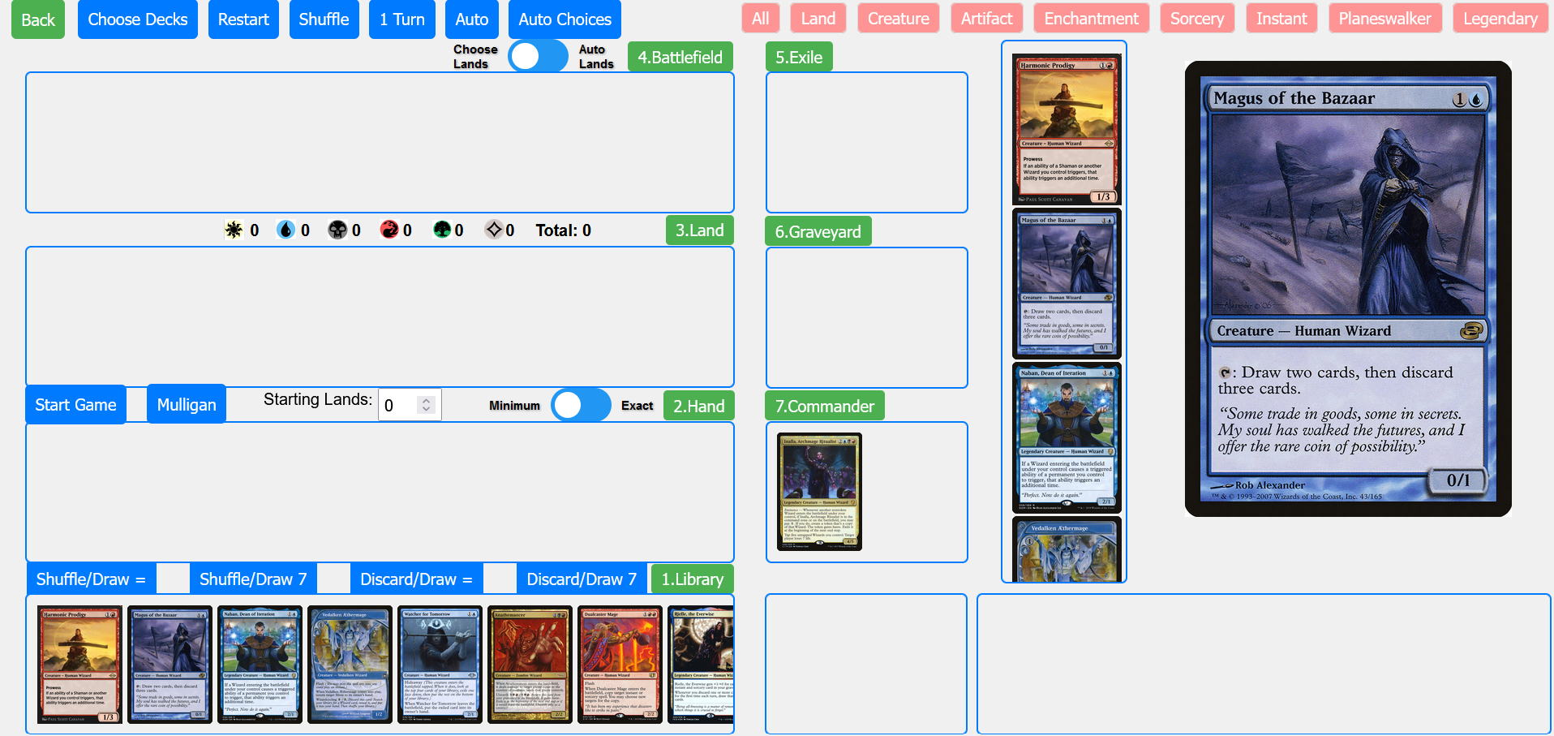
Before pressing the start game, you can set the number of lands you want in your starting hand. If you set the switch to minimum, it will draw at least that number of lands in your starting hand. If set to exact, it will draw you exactly that number of lands. You can also do this after pressing the start game button, before pressing the mulligan button.

Slide 14
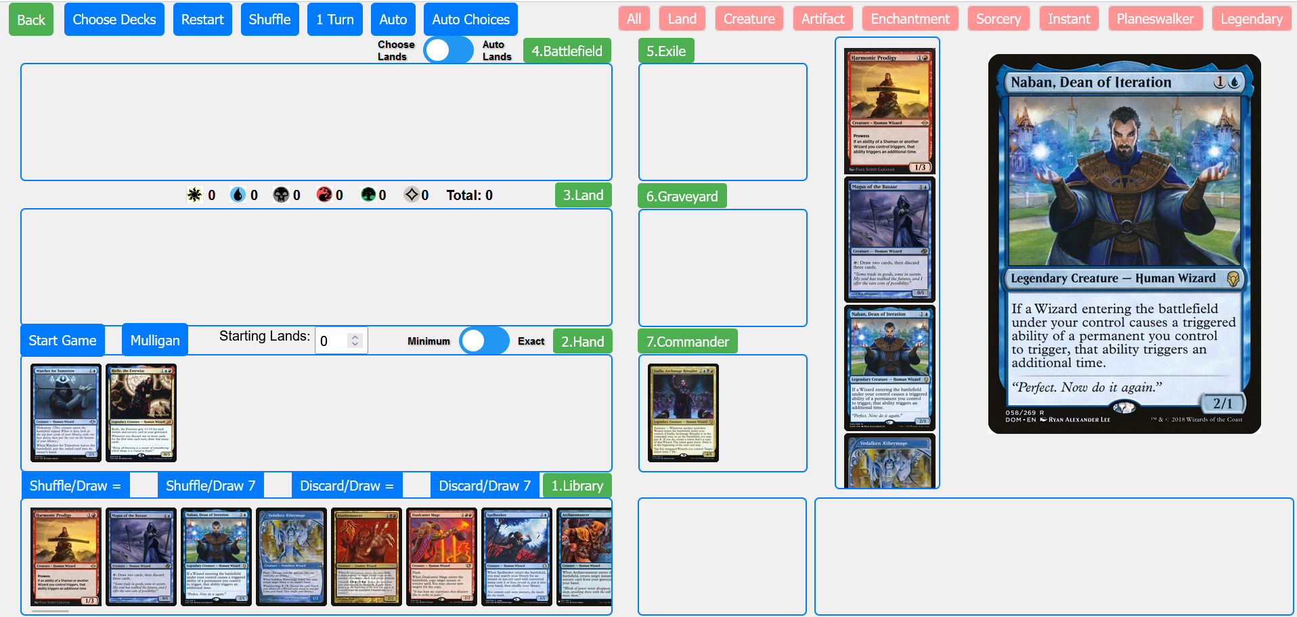
If you want to move an image, you can hover your mouse over an image and press the number key of the corresponding section button, to move cards to that section.

Slide 15
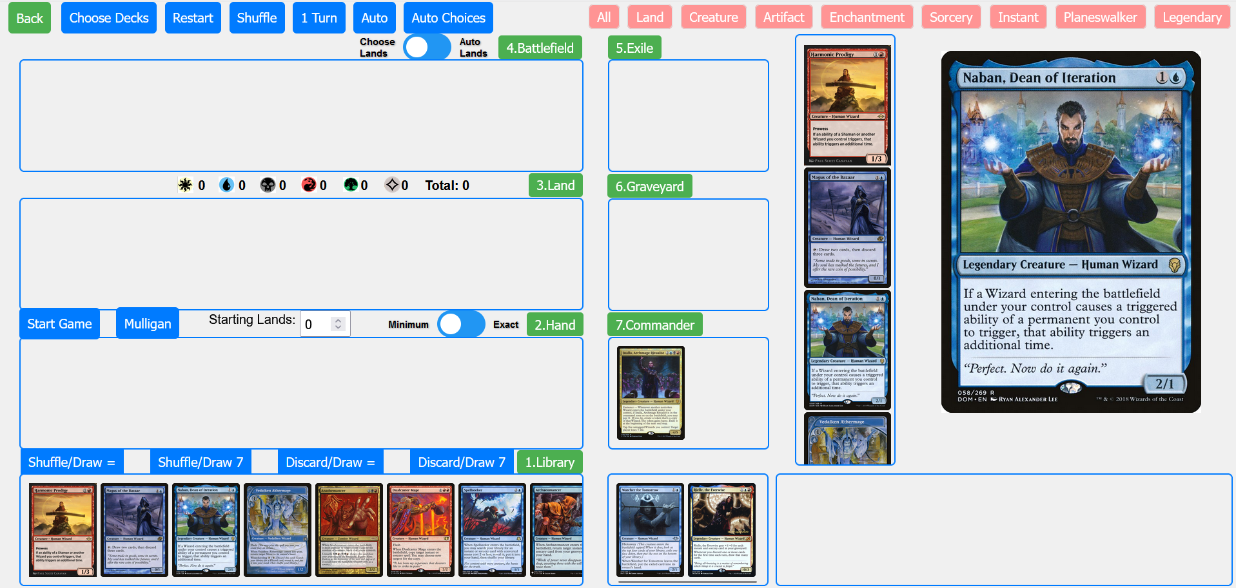
If you want to store cards away from other sections, for cards with suspend, or temporarily being exiled, you can store them here by pressing shift while having your mouse on an image.

Slide 16
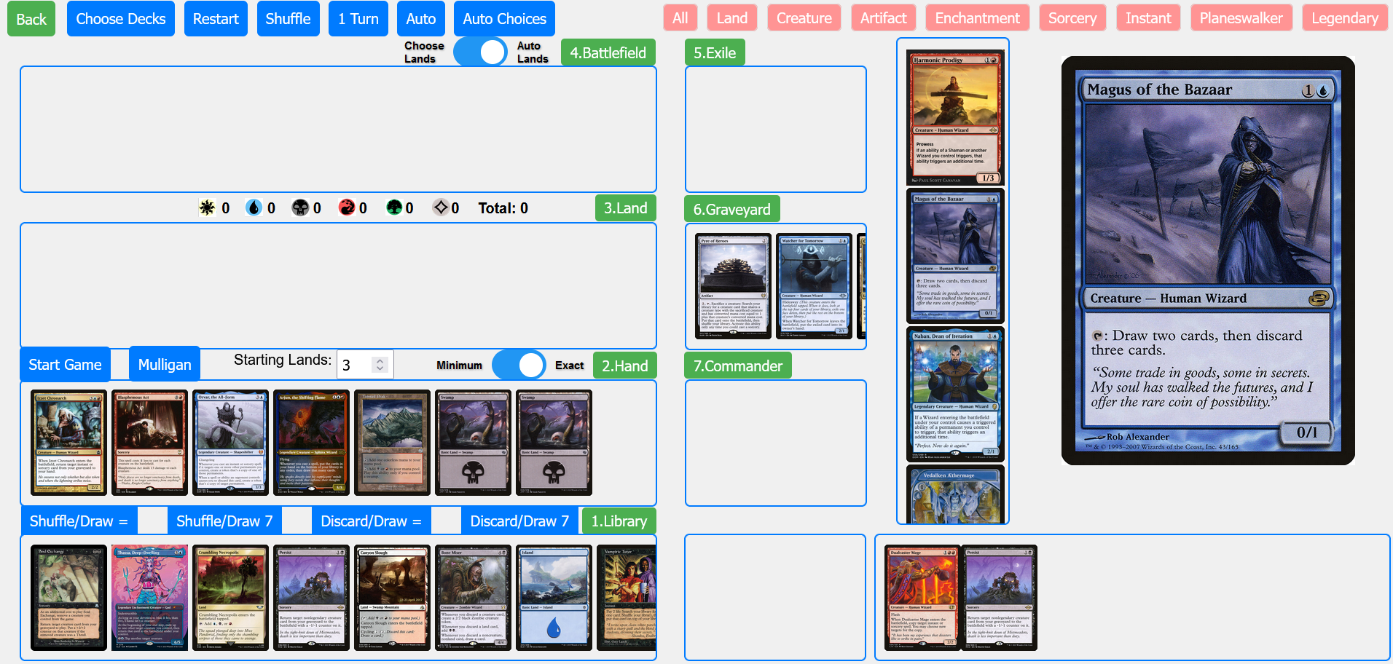
These buttons can be used for cards that have you discard or shuffle your hands back into your library and draw cards. The most common are shuffling or discarding your hand and drawing the same number of cards or shuffling or discarding your hand and drawing 7.

Slide 17
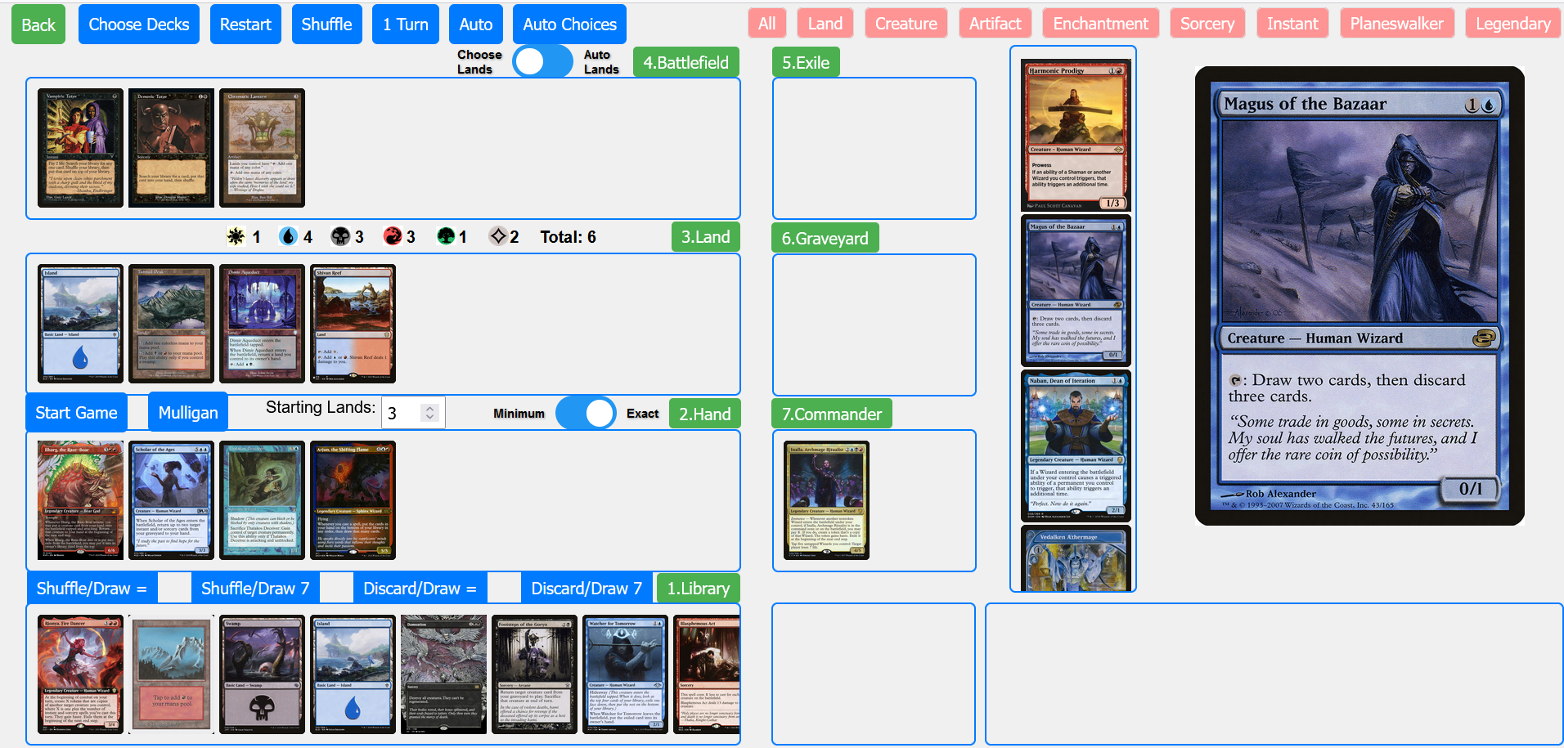
As you play lands and cards that produce mana, the mana counter here will tell you what mana you have available.

Slide 18
The mana symbols tell you the maximum amount of mana of that color you can produce, where the end is the total amount of mana you have.

Slide 19
Note: Currently, when auto playing cards, it doesn’t consider that when tapping a land to produce 1 of the mana the land can produce, you loose access to the other mana it can produce.
Note: Currently, when auto playing cards, it doesn’t consider that when tapping a land to produce 1 of the mana the land can produce, you loose access to the other mana it can produce.

Slide 20
Most instances, when playing multiple cards, you would be able to arrange tapping lands to play all of them. But keep an eye out, you may have to stop the game to move cards back.

Slide 21
Most instances, when playing multiple cards, you would be able to arrange tapping lands to play all of them. But keep an eye out, you may have to stop the game to move cards back.

